Slide 1
Cascaded Debiasing: Studying the Cumulative Effect of Multiple Fairness-Enhancing Interventions
Bhavya Ghai¹, Mihir Mishra² and Klaus Mueller¹
Los Altos High School²
Stony Brook University¹
Notes:
Good afternoon everyone. I am Bhavya Ghai from Computer Science department.
Today, I will be talking about a very interesting and relevant problem about how Biased Algorithms are affecting our society & what can we do to make it more fair, accountable & transparent.
Let’s start off with a recent example

Slide 2



Algorithmic Bias
Algorithmic Bias occurs when computer systems discriminate based on an individual’s inherent characteristic such as gender or acquired traits such as nationality that are protected classes under law and are irrelevant to the decision-making process.
s | p | q | r | y
Data Curation
Data
Preprocess
Real
World
ML
Model
Real world examples of Algorithmic Bias include:
COMPAS recidivism risk prediction
Amazon’s recruitment algorithm
PredPol’s predictive policing algorithm
Population
groups
Algorithmic Bias is the imminent AI danger impacting millions daily
Notes:
Online Ad delivery, healthcare, facial recognition technology

Slide 3
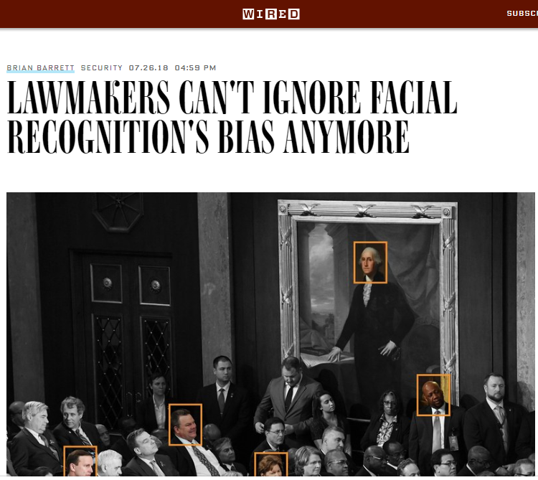
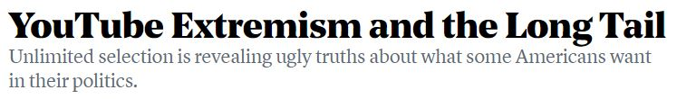
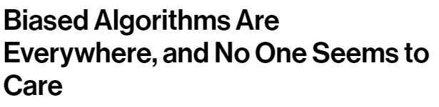
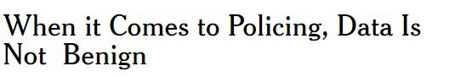
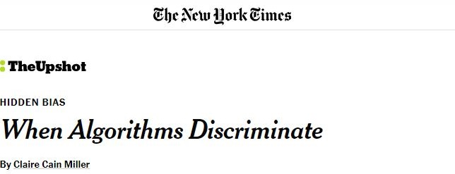
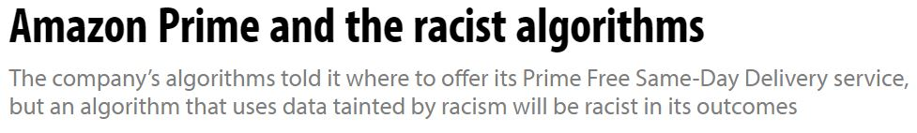
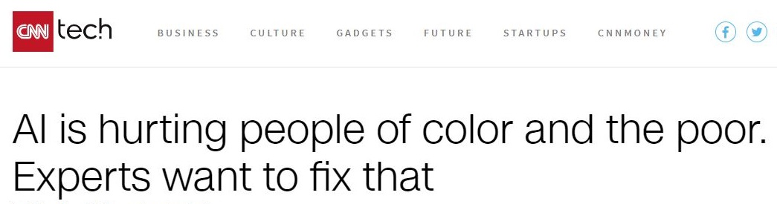
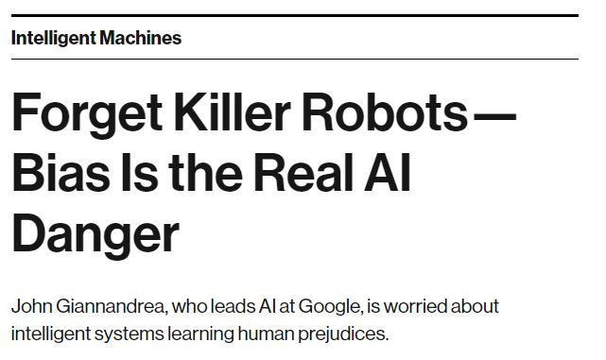
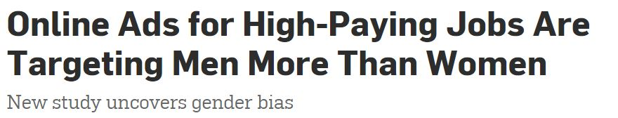
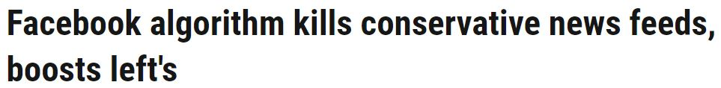

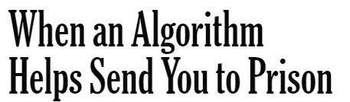
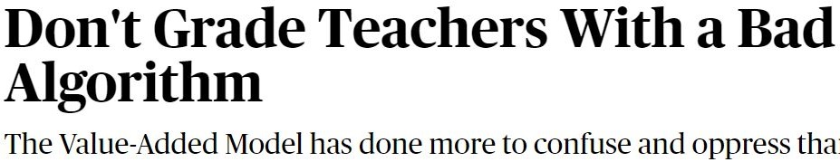
In the media …
Notes:
28 members of Congress with publicly available mug shots
YouTube’s recommender algorithm has a bias toward inflammatory/extremist content. If you watch Donald trump rallies, you might end up with white extremist videos. If you watch vegatarina videos, it might lead you to veganism
Amazon launched same day delivery feature & high return customers. All the left out neighborhoods were black.
Our society has given huge sacrifices to reach where we are today and we can’t let algorithms make our world more racist, sexist and stereotypical.

Slide 4
Motivation
Recent years have seen a huge surge of fairness-enhancing interventions that operate at different stages of the ML pipeline. However, the problem is far from being solved. So, there is a need for better interventions to reduce bias even further.
Existing literature focuses on curbing algorithmic bias by intervening at ‘a’ particular stage of the ML pipeline. However, algorithmic bias might still flourish via other stages/components of the ML pipeline.
Pre-processing
In-processing
Post-processing
Debiased
data
Fair
Model
Fair
Prediction
Dataset
ML Model
Predictions
Evaluation
Standard ML Pipeline
There is a need to ensure fairness across the ML pipeline instead of a single stage

Slide 5

Cascaded Interventions
One way to achieve more fairness across the ML pipeline can be to apply multiple fixes (interventions) at different stages of the ML pipeline where bias can emerge from. We refer to such a series of fairness-enhancing interventions as cascaded interventions.
Pre-processing
Debiased
data
Dataset
ML Model
Predictions
Evaluation
Standard ML Pipeline

Slide 6
Cascaded Interventions
One way to achieve more fairness across the ML pipeline can be to apply multiple fixes (interventions) at different stages of the ML pipeline where bias can emerge from. We refer to such a series of fairness-enhancing interventions as cascaded interventions.
In-processing
Fair
Model
Dataset
ML Model
Predictions
Evaluation
Standard ML Pipeline

Slide 7
Cascaded Interventions
One way to achieve more fairness across the ML pipeline can be to apply multiple fixes (interventions) at different stages of the ML pipeline where bias can emerge from. We refer to such a series of fairness-enhancing interventions as cascaded interventions.
Post-processing
Fair
Prediction
Dataset
ML Model
Predictions
Evaluation
Standard ML Pipeline

Slide 8
Cascaded Interventions
One way to achieve more fairness across the ML pipeline can be to apply multiple fixes (interventions) at different stages of the ML pipeline where bias can emerge from. We refer to such a series of fairness-enhancing interventions as cascaded interventions.
In-processing
Post-processing
Fair
Model
Fair
Prediction
Dataset
ML Model
Predictions
Evaluation
Standard ML Pipeline

Slide 9
Cascaded Interventions
One way to achieve more fairness across the ML pipeline can be to apply multiple fixes (interventions) at different stages of the ML pipeline where bias can emerge from. We refer to such a series of fairness-enhancing interventions as cascaded interventions.
Pre-processing
Post-processing
Debiased
data
Fair
Prediction
Dataset
ML Model
Predictions
Evaluation
Standard ML Pipeline

Slide 10
Cascaded Interventions
One way to achieve more fairness across the ML pipeline can be to apply multiple fixes (interventions) at different stages of the ML pipeline where bias can emerge from. We refer to such a series of fairness-enhancing interventions as cascaded interventions.
Pre-processing
In-processing
Post-processing
Debiased
data
Fair
Model
Fair
Prediction
Dataset
ML Model
Predictions
Evaluation
Standard ML Pipeline
This approach is motivated from the real world where different laws/policies/guidelines try to alleviate social inequality by intervening at multiple stages of life like education, employment, promotion, etc. Examples include Affirmative action in the US and Caste based reservation in India.
Social Welfare Interventions
College Admissions
Job
Promotion
Stages of Life

Slide 11
Research Questions
RQ1: Effect of Cascaded Interventions on Fairness metrics
Does intervening at multiple stages reduce bias even further? If so, does it always hold true?
What is the impact on Group fairness metrics and Individual fairness metrics?
RQ2: Effect of Cascaded Interventions on Utility metrics
How do utility metrics like accuracy and F1 score vary with different number of interventions?
Existing literature discusses the presence of Fairness Utility tradeoff for individual interventions. Does it hold true for cascaded interventions?
RQ3: Effect of Cascaded Interventions on Population Groups
How are the privileged and unprivileged groups impacted by cascaded interventions in terms of F1 score, False negative rate, etc.?
Are there any negative impacts on either groups?
RQ4: How do different cascaded interventions compare on fairness and utility metrics?
In this work, we conduct an empirical study to answer these research questions

Slide 12
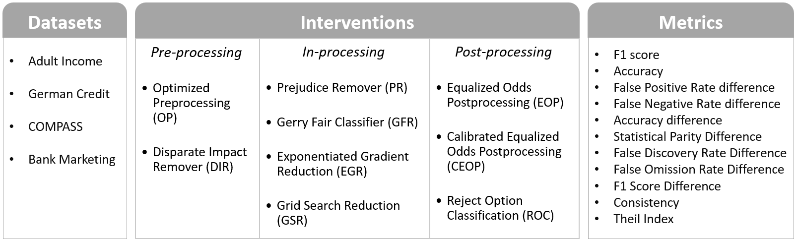
Experimental Setup
Problem Type: Binary classification
Data Type: Tabular datasets
Number of sensitive attributes: 1 per dataset
ML Model: Logistic Regression
We have used IBM’s AIF 360 open-source toolkit to conduct all experiments for this paper. More specifically, we leveraged 4 datasets, 9 fairness enhancing interventions and 11 evaluation metrics from this toolkit as shown below.

Slide 13
Fairness-Enhancing Interventions
We have considered 9 individual interventions and 50 different combinations of interventions.
Cascaded interventions, like OP + GFC + ROC, are represented by adding a ‘+’ sign between the constituting interventions.
OP + GFC means executing the Optimized preprocessing (OP) intervention followed by the Gerry Fair classifier (GFC).
We have also considered a baseline case, i.e., no interventions for all stages for the ML pipeline (represented as ‘Logistic Regression’)
In-processing
4
8
12
24
2
3
6
Pre-processing
Post-processing
Distribution of fairness-enhancing interventions considered in this paper.
We have considered 60 interventions (baseline + 9 individual + 50 cascaded)

Slide 14
Experimental Data
11 metrics + metrics for individual groups
Each version corresponds to a different seed value for train/test data split
60
interventions

Slide 15
Experimental Data
Adult Income Dataset
German Credit Dataset
COMPAS Dataset
Bank Marketing Dataset

Slide 16
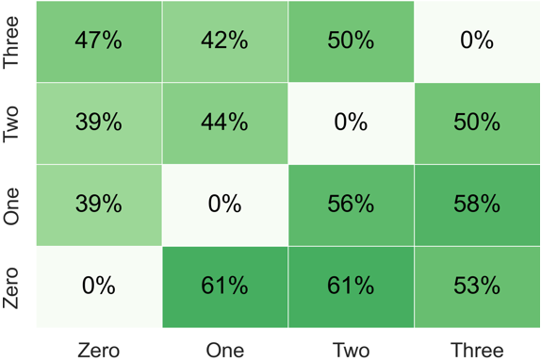
RQ1: Effect on Fairness
Fairness Heatmap: A cell (i,j) represents the percentage of cases where j interventions yielded better fairness metrics than i interventions. Here, i represents rows and j represents columns.

Slide 17
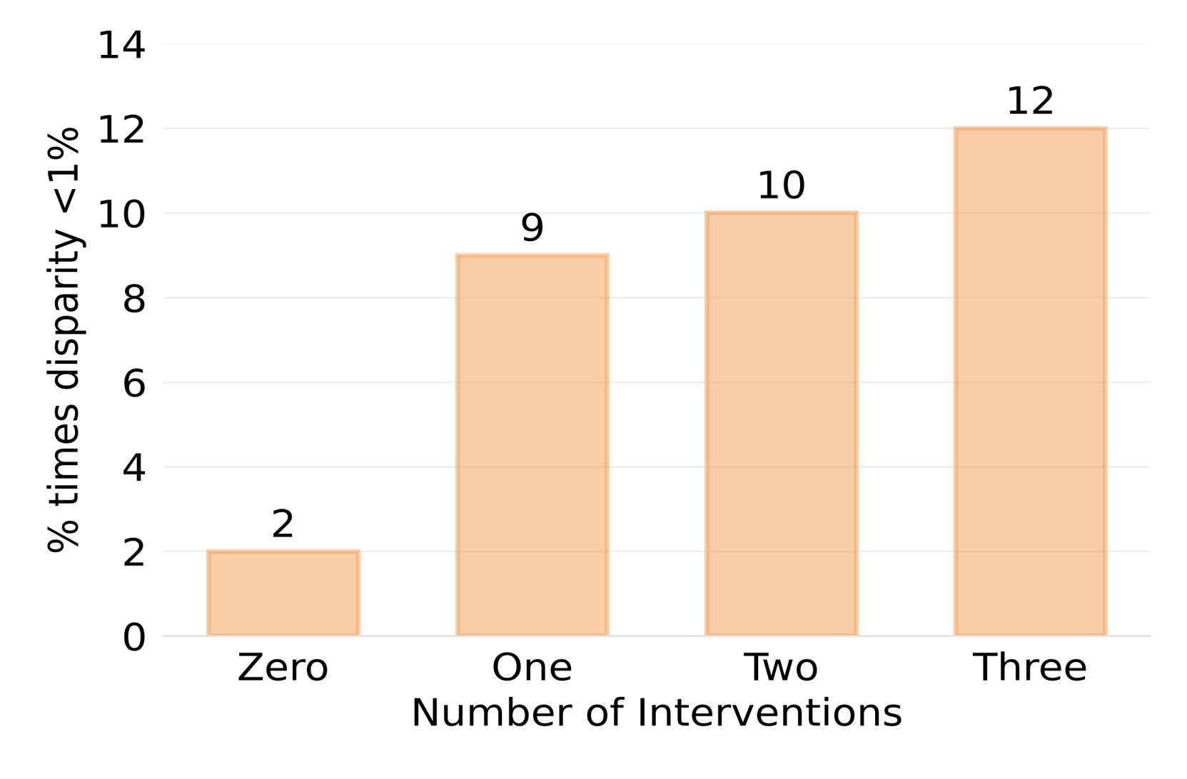
RQ1: Effect on Fairness
Fairness Heatmap: A cell (i,j) represents the percentage of cases where j interventions yielded better fairness metrics than i interventions. Here, i represents rows and j represents columns.
Percentage of times the disparity between the privileged and unprivileged groups was less than 1% across all group fairness metrics. A higher value means more group fairness.
More interventions lead to better fairness on aggregate.

Slide 18
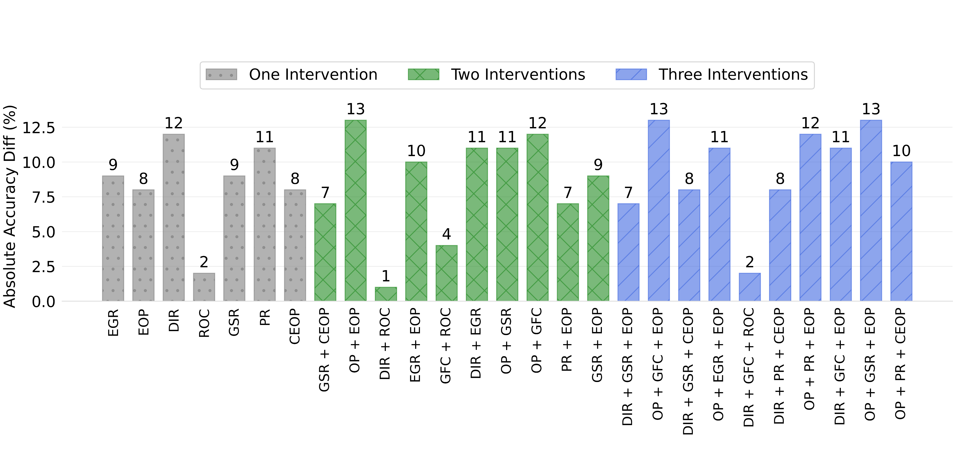
RQ1: Does Fairness always improve with more Interventions?
Lower values means more fairness
It is not always the case that more interventions will result in more fairness
Notes:
There is a cost to be paid for adding more interventions.
Typically, more interventions lead to worse utility

Slide 19
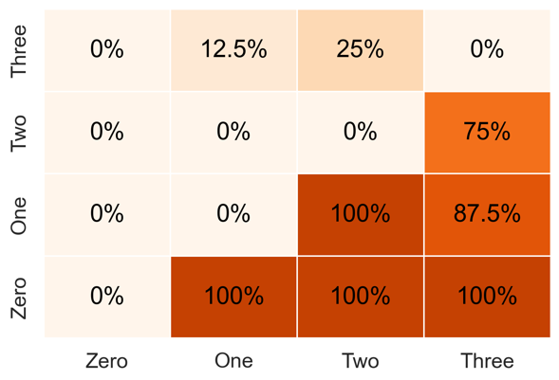
RQ2: Effect on Utility
Utility Heatmap: A cell (i,j) represents the percentage of cases where j interventions yielded worse utility metrics than i interventions. Here, i represents rows and j represents columns.
Notes:
There is a cost to be paid for adding more interventions.
Typically, more interventions lead to worse utility

Slide 20
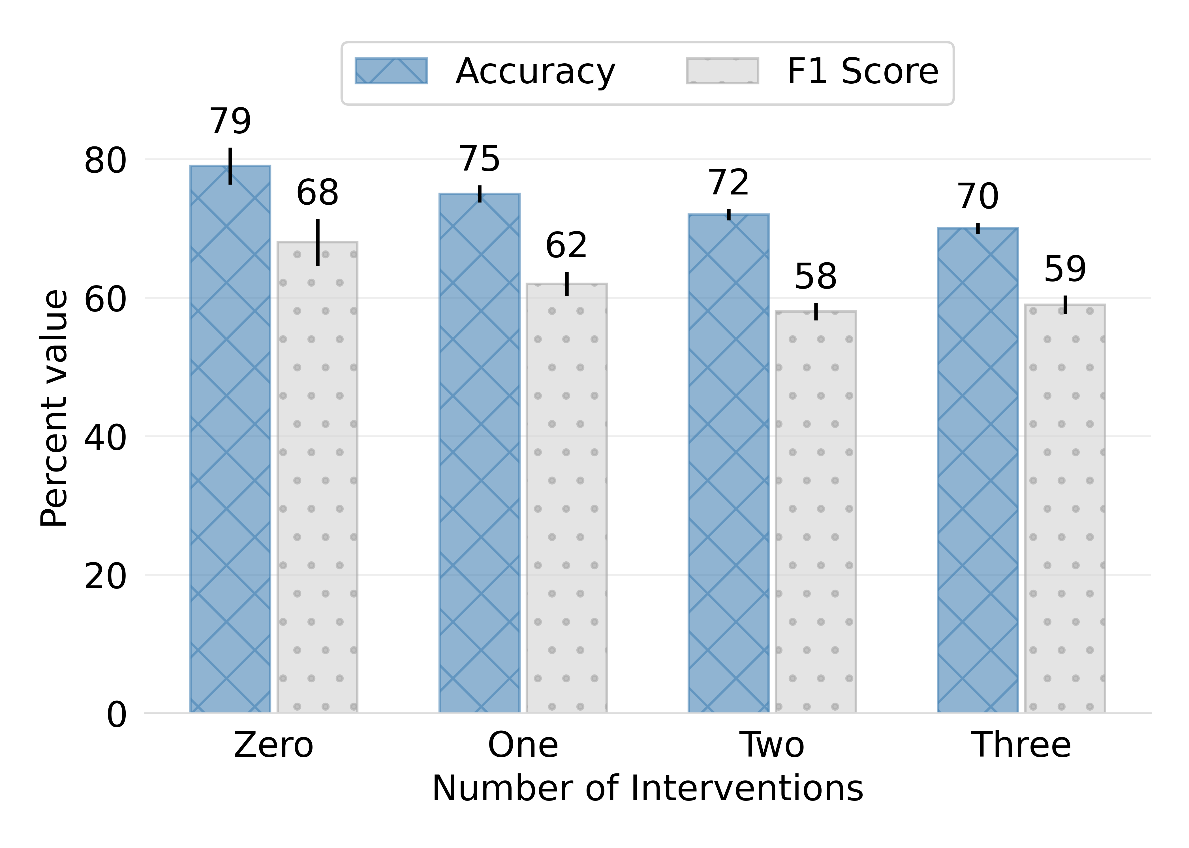
RQ2: Effect on Utility
Utility Heatmap: A cell (i,j) represents the percentage of cases where j interventions yielded worse utility metrics than i interventions. Here, i represents rows and j represents columns.
Mean Accuracy and F1 Score for different numbers of interventions across all datasets.
One should not blindly opt for more interventions
Notes:
There is a cost to be paid for adding more interventions.
Typically, more interventions lead to worse utility

Slide 21
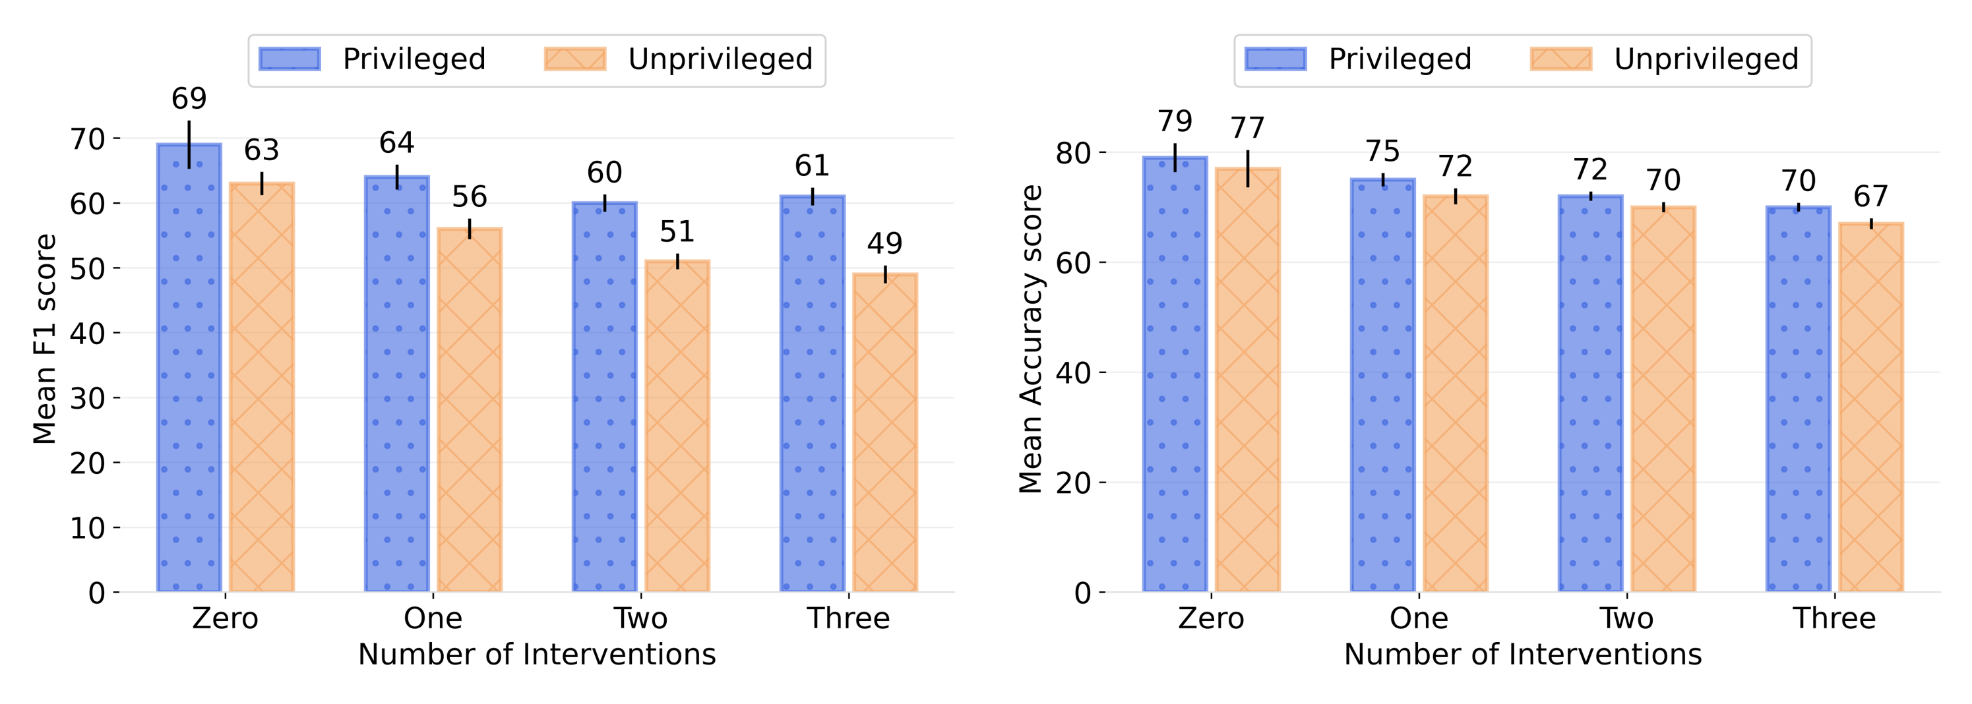
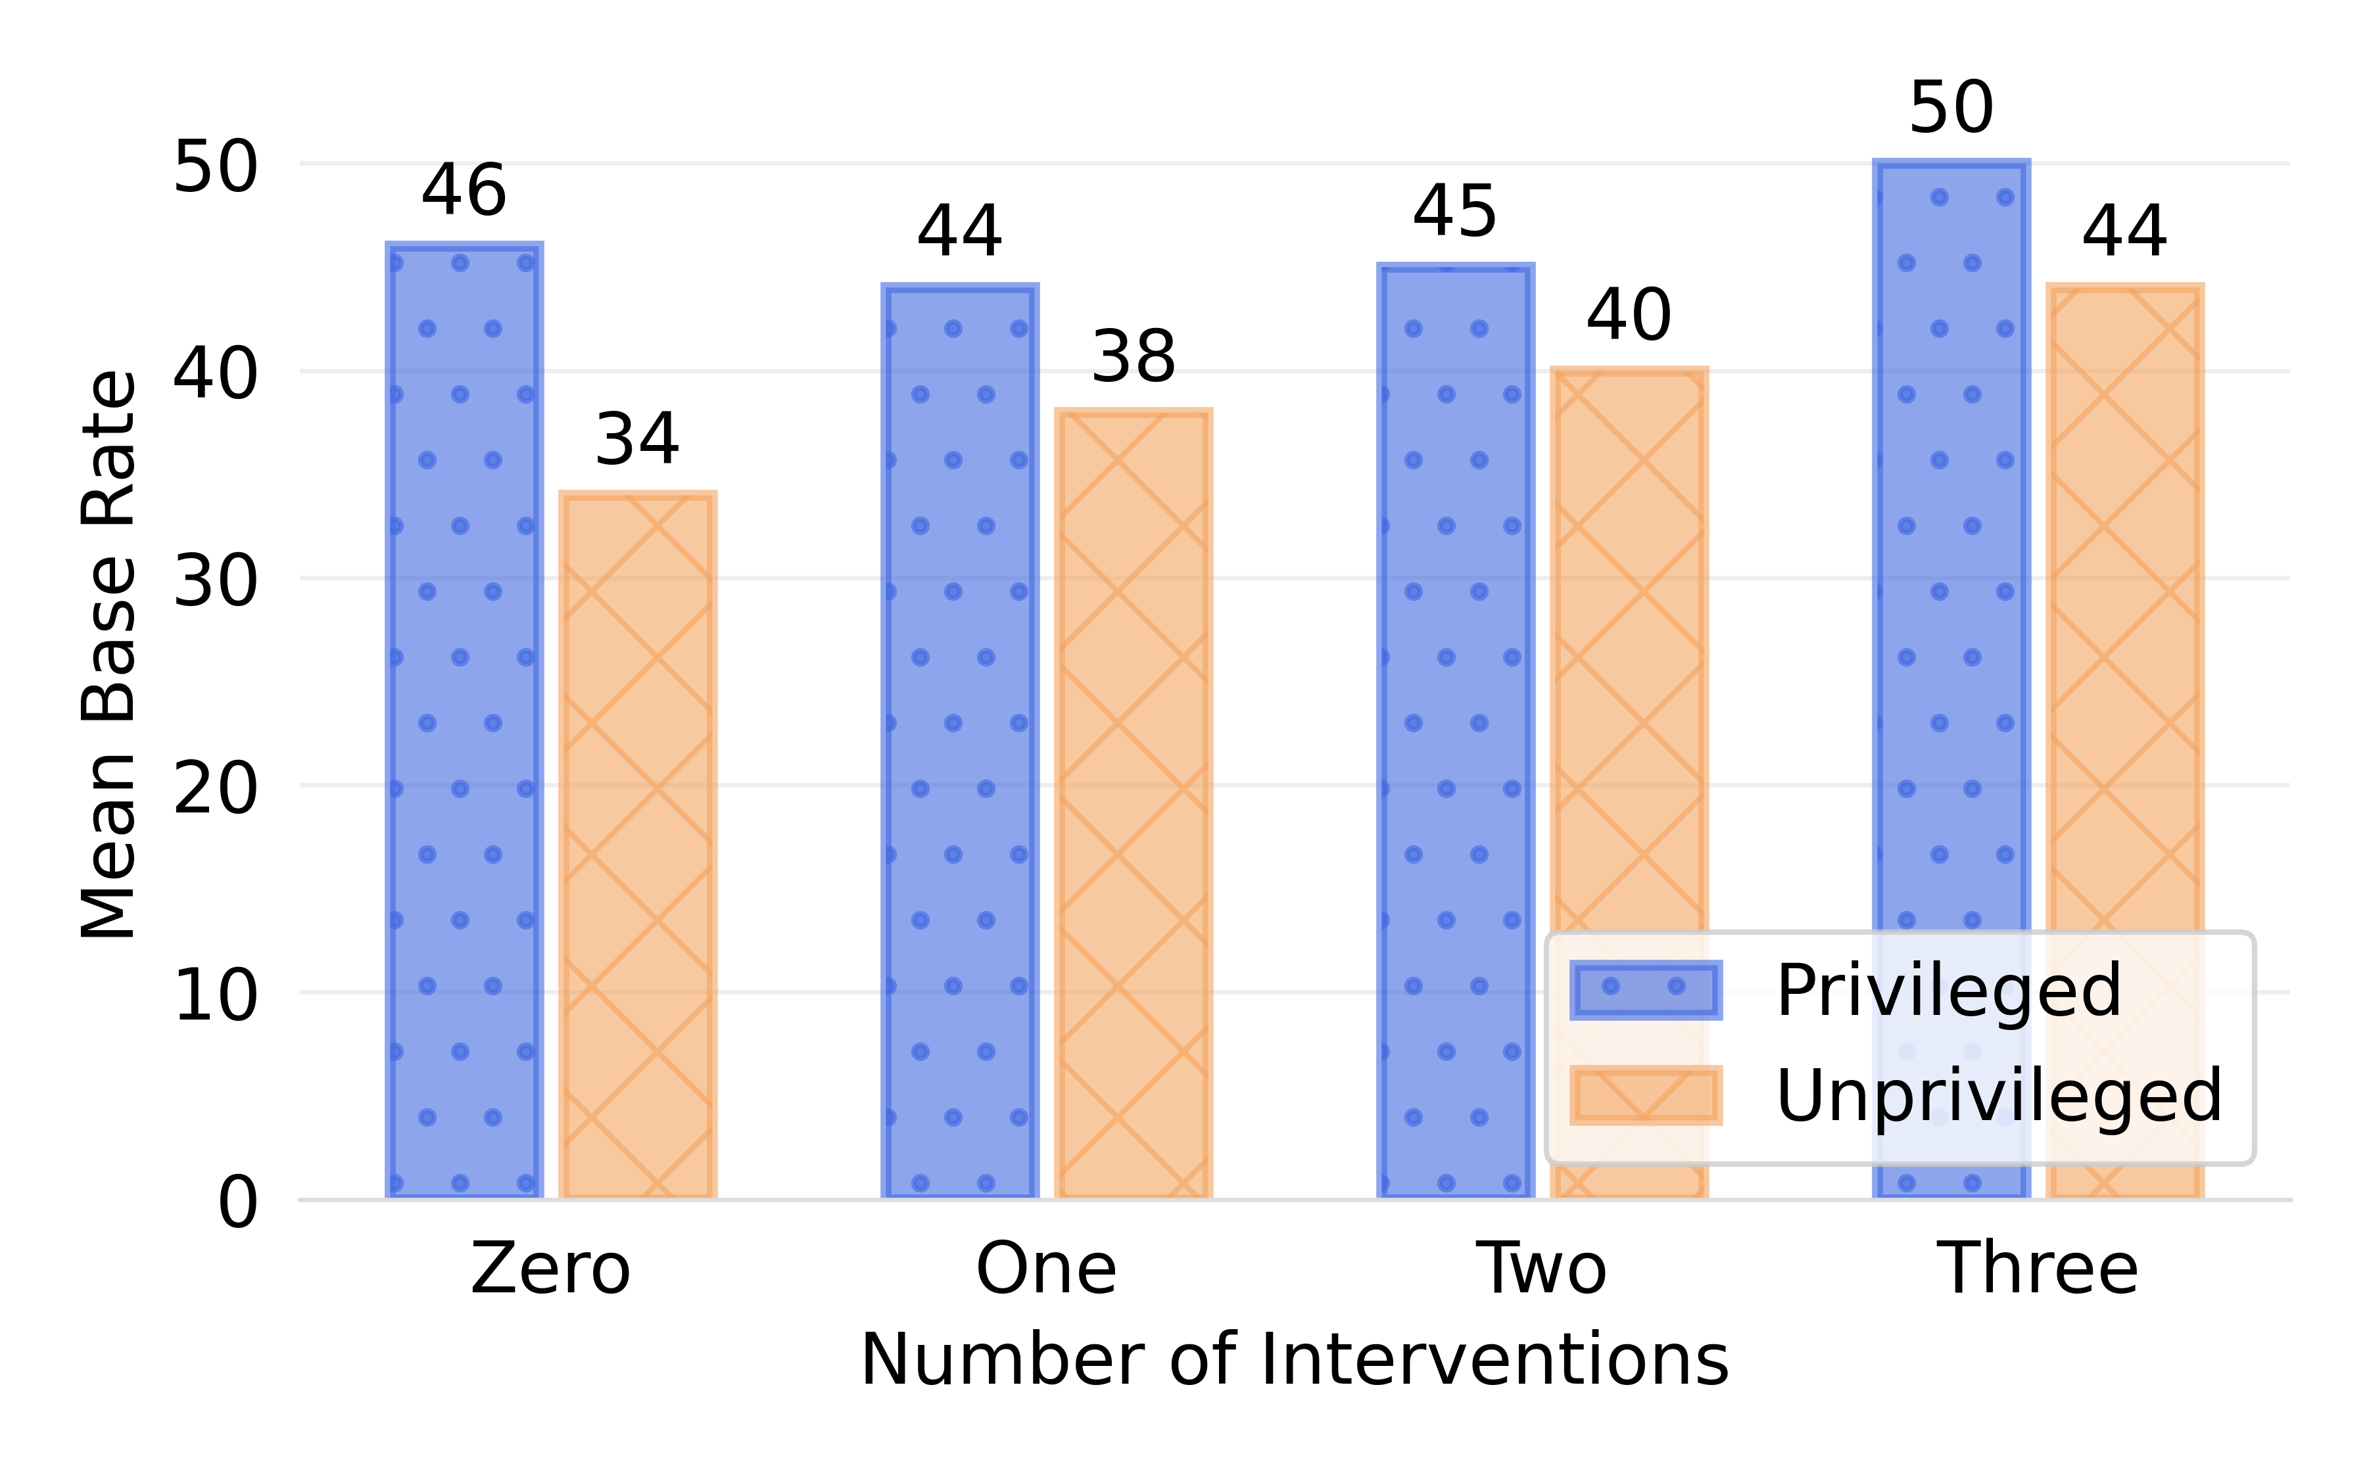
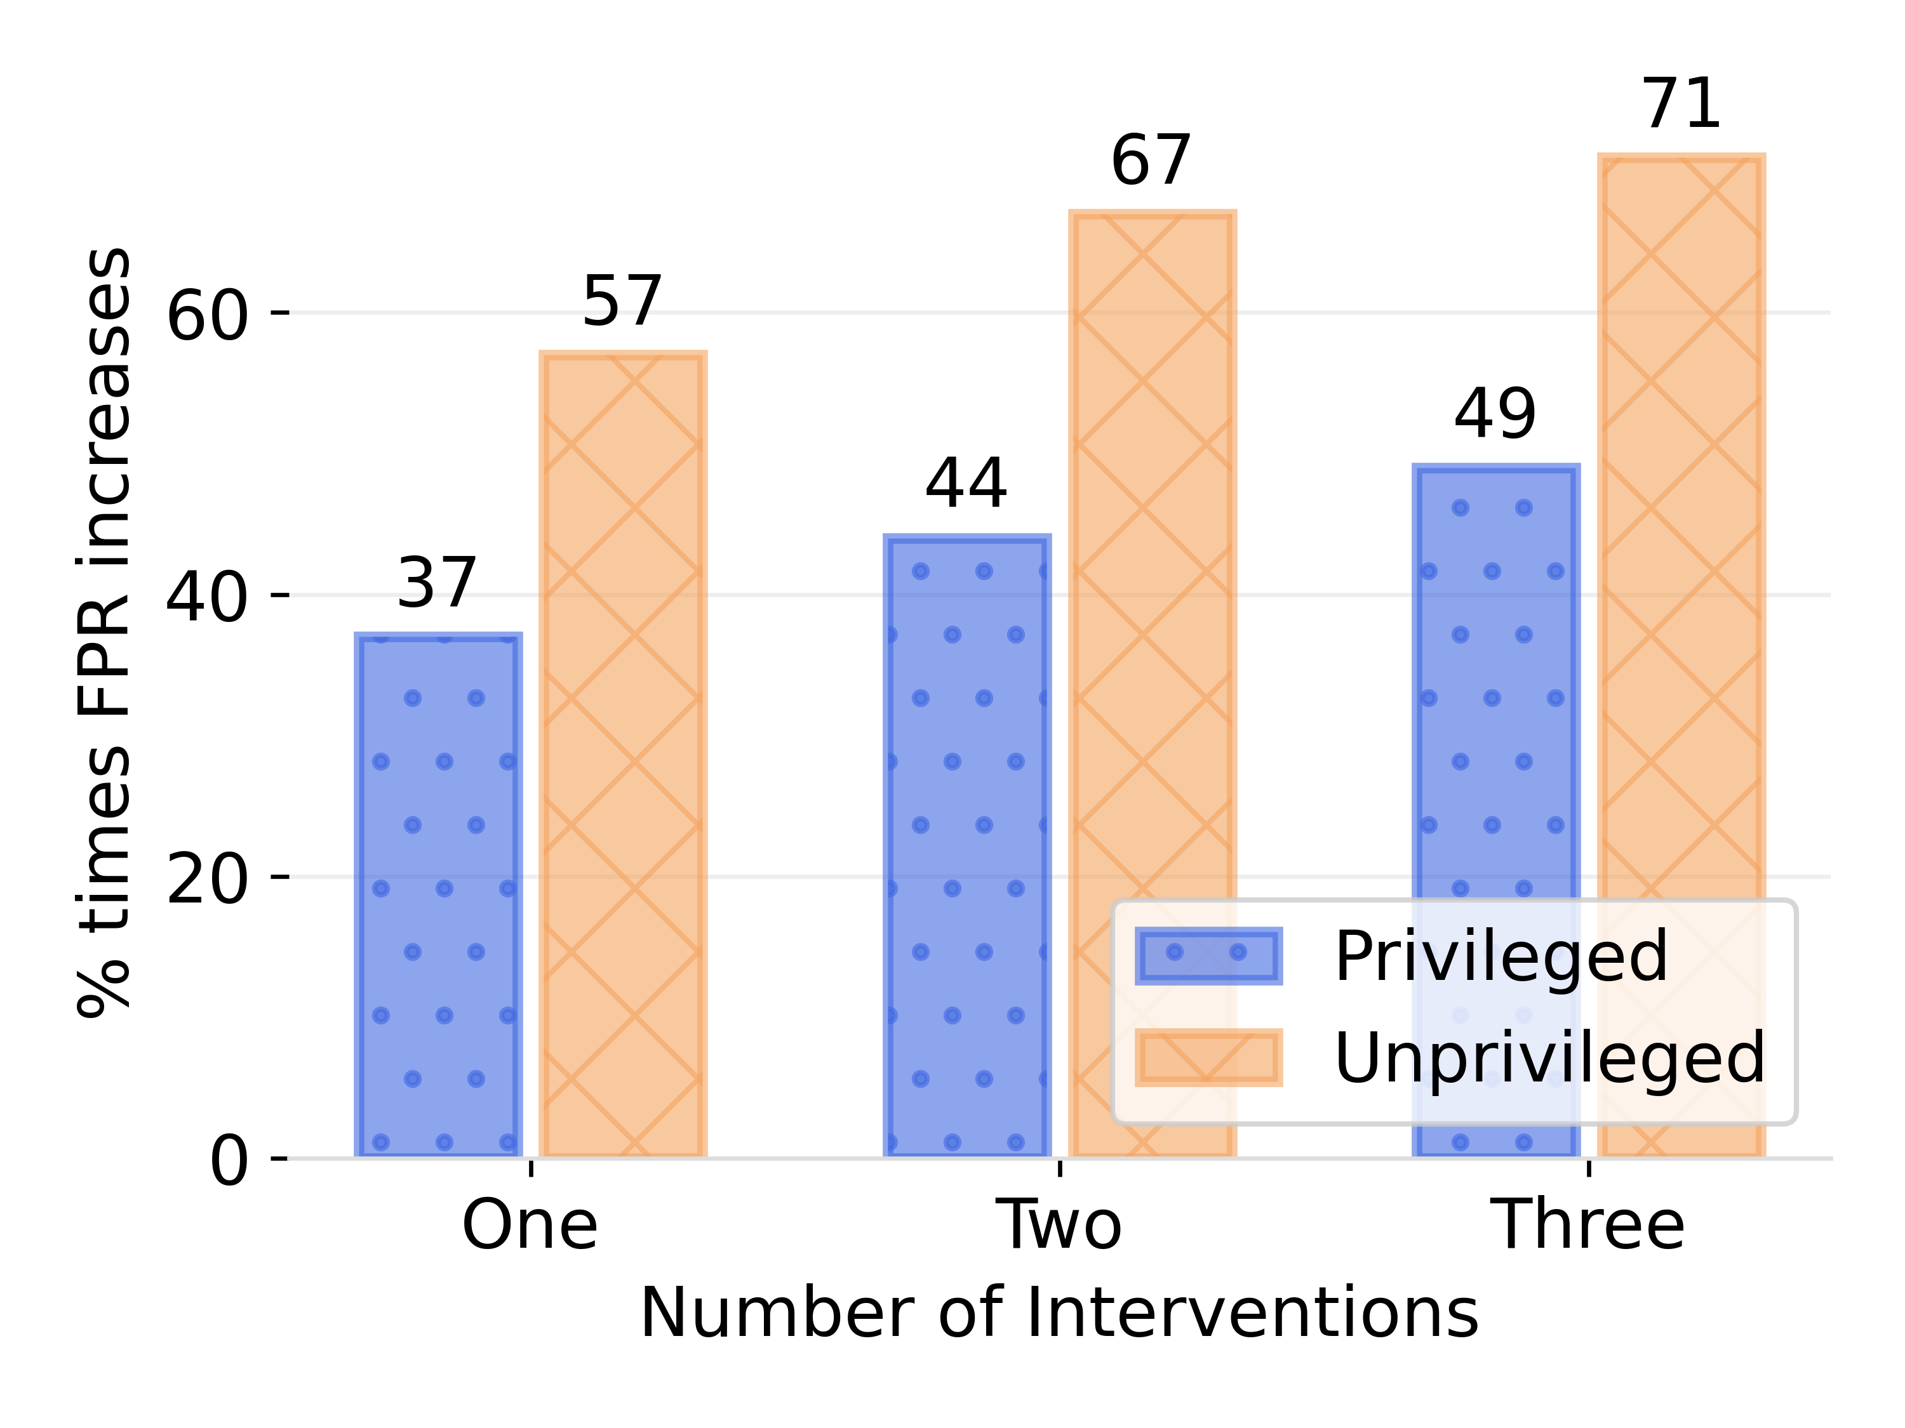
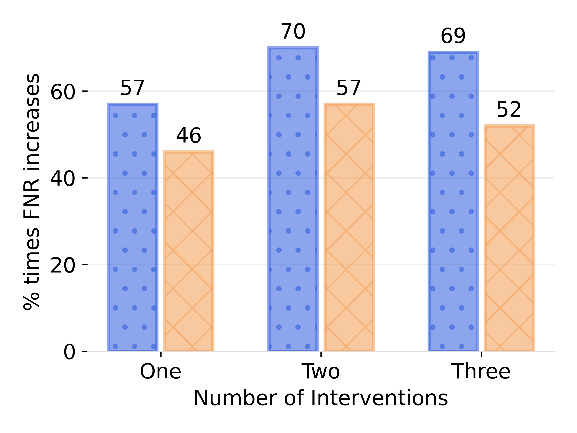
RQ3: Effect on Individual Groups
F1 Score
Accuracy
Base Rate
False Positive Rate
False Negative Rate

Slide 22
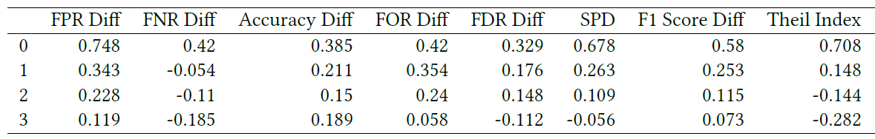
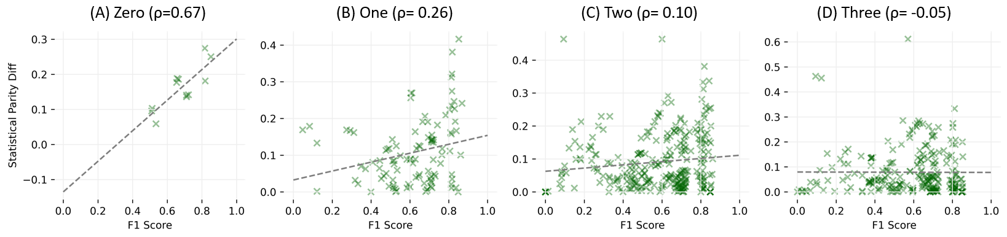
Effect on Fairness-Utility Tradeoff
Spearman correlation coefficient between F1 score and fairness metrics for different number of interventions.
Relation between Statistical Parity difference and F1 score for different numbers of interventions from 0 to 3 (A - D).
With more number of interventions, fairness-utility tradeoff weakens

Slide 23
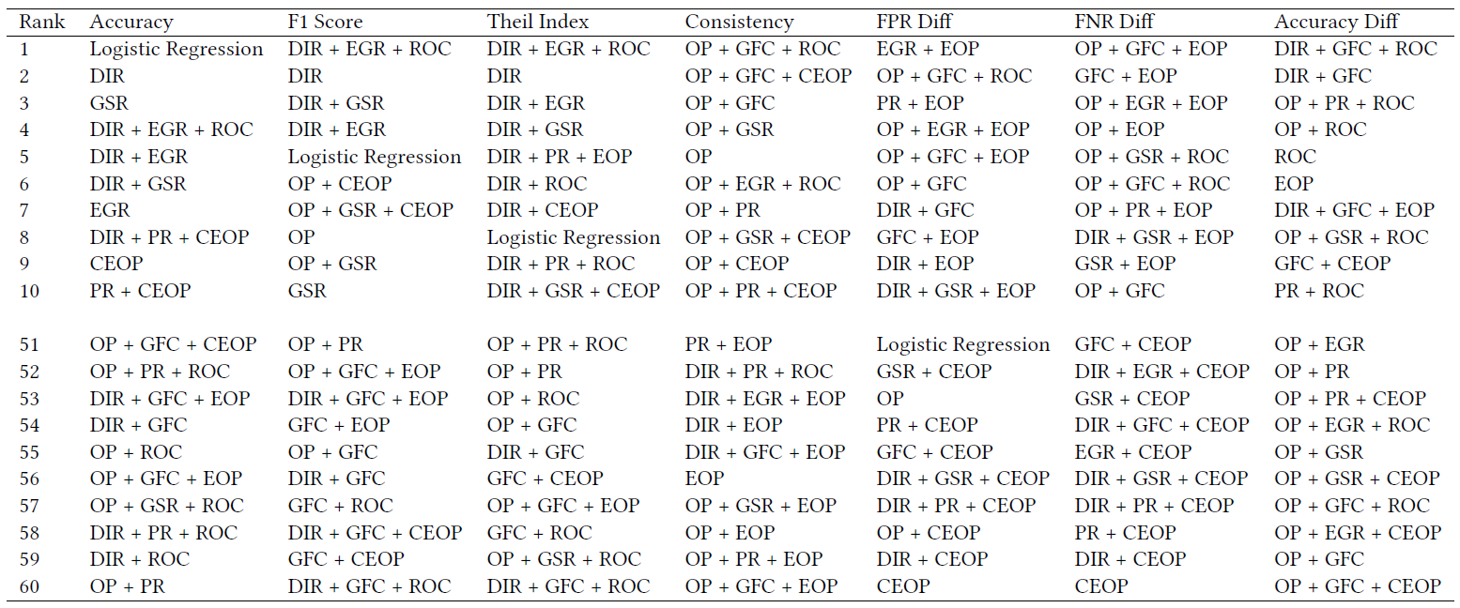
RQ4: Comparison between Interventions
If the end goal is to achieve the best accuracy, do not use any intervention
Notes:
First explain the table and sorting for metrics
the best performing intervention for any metric is either Logistic Regression (No Intervention) or a combination of two or more interventions.

Slide 24
RQ4: Comparison between Interventions
Applying more interventions does not always lead to a significant loss in utility
Notes:
we observe that the best performing intervention is mostly unique for each one of them. In other words, there is no silver bullet for all fairness metrics
the best performing intervention for any metric is either Logistic Regression (No Intervention) or a combination of two or more interventions.

Slide 25
RQ4: Comparison between Interventions
There are several interventions that rank worse than the baseline case
Notes:
Among the 10 bottom ranked interventions across all fairness metrics, Logistic Regression occurs only a few times.
So, one should choose the interventions wisely cause otherwise one might land into a worst situation that they started out for.

Slide 26
RQ4: Comparison between Interventions
There is no silver bullet for all fairness metrics
Notes:
For the fairness metrics, we observe that the best performing intervention is mostly unique for each one of them
ML practioners need to prioritize which metrics are more important to them and then choose interventions accordingly

Slide 27
RQ4: Comparison between Interventions
The top interventions for all metrics are predominantly cascaded interventions
Notes:
These observations further motivate the efficacy of cascaded interventions over individual interventions.

Slide 28
RQ4: Comparison between Interventions
Certain interventions are more compatible/incompatible with another
Notes:
Among the top 10 interventions across all metrics, OP + GFC + ROC occurs the most number of times.
Similarly, OP + GFC + EOP occurs the most number of times among the worst 10 interventions across metrics.
Changing an ingredient can drastically impact the outcome.
For instance, swapping ROC with EOP resulted in the entire combination (OP + GFC + ROC) to change from being one of the top ranked to one of the worst ranked interventions

Slide 29
Key Takeaways
Applying multiple interventions results in better overall fairness and lower utility than individual interventions on aggregate.
Adding more interventions do no always result in better fairness or worse utility.
The likelihood of achieving high performance (F1 Score) along with high fairness increases with larger number of interventions.
Fairness-enhancing interventions can negatively impact different population groups, especially the privileged group.
This study also highlights the need for new fairness metrics that account for the impact on different population groups apart from just the disparity between groups.
We offer a list of combinations of interventions that perform best for different fairness and utility metrics to aid the design of fair ML pipelines.
For more details, refer to- github.com/bhavyaghai/Cascaded-Debiasing

Slide 30

Thanks for your Attention!
For more details, including the code, refer to:
github.com/bhavyaghai/Cascaded-Debiasing

Slide 31



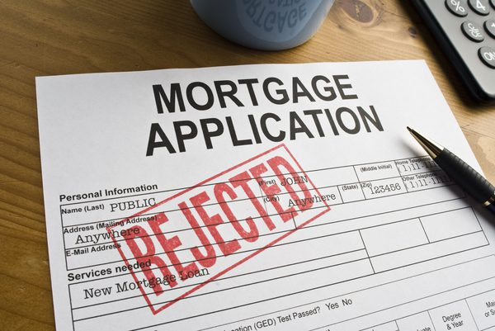

Algorithmic Bias
When computer systems discriminate based on an individual’s inherent characteristic such as gender, or acquired traits such as nationality, which are protected classes under law and are irrelevant to the decision-making process, it constitutes Algorithmic Bias.
Algorithmic Bias is the imminent AI danger impacting millions daily
Notes:
There are multiple definitions of fairness and every paper talks about one definition or other so all of the results can be questioned
Fairness – Without a concrete definition of bias, how can you model it correctly. Different research groups are not on the same page.
Transparency – Given a decision, we can’t ask why?
Accountability – Who’s responsible? Can be we punish algorithm? Should we punish its developers (who can’t fully understand its behaviour)?
Domain knowledge – Deep learning models are just mathematical formulations which can be useful sometimes. They don’t understand emotions, cultures, human values, etc.
Trust – Given that these algorithms mighn’t be fair. We can’t ask them any questions. We can’t punish them either. Can we trust them?

Slide 32
Two Possible Interpretations
ML Perspective
Social Justice Perspective
The prime focus is to train a ML model that best fits the underlying dataset
The prime focus is to train a ML model
that best fits the underlying dataset
Objective
ML Perspective | Social Justice Perspective
The focus is to train a ML model that best fits the underlying dataset

Slide 33
RQ1: Effect on Fairness
Fairness Heatmap: A cell (i,j) represents the percentage of cases where j interventions yielded better fairness metrics than i interventions. Here, i represents rows and j represents columns.

Slide 34
RQ1: Effect on Fairness
Fairness Heatmap: A cell (i,j) represents the percentage of cases where j interventions yielded better fairness metrics than i interventions. Here, i represents rows and j represents columns.
Percentage of times the disparity between the privileged and unprivileged groups was less than 1% across all group fairness metrics. A higher value means more group fairness.
More interventions lead to better fairness on aggregate.

Slide 35
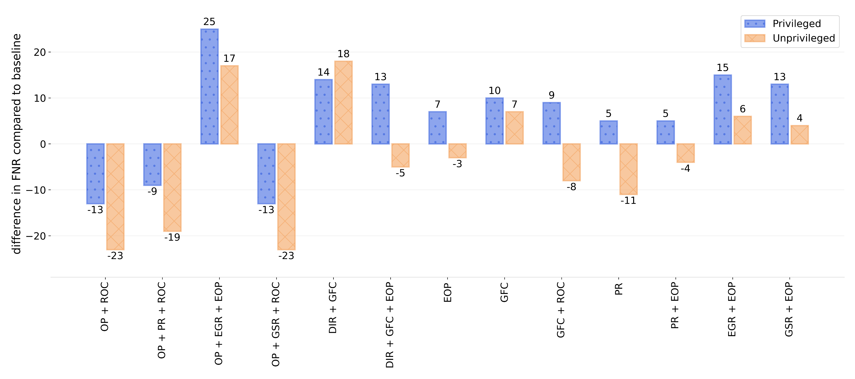
How is disparity reduced?
Different interventions that reduce FNR Diff fairness metric compared to baseline
Need to prioritize interventions that reduce disparity while not hurting any group
Notes:
we observe that for 10 out of the 13 interventions FNR has actually increased for one or both groups

